Slide 1











EFFECT OF ALLOYING ON LATTICE PARAMETERS AND STACKING FAULT ENERGIES FOR FCC LATTICE.
BY :
ISHAN SHRIVASTAVA - 210005021

Slide 2

WHAT IS STACKING FAULT ENERGY?
stacking fault energy is a kind of defect energy corresponding to the abnormal packing of atomic layers.
It is basically the energy difference between the perfect and the imperfect crystal systems per unit area.
It is of three types - 1)Extrinsic
2)Intrinsic
3)Twin

Slide 3


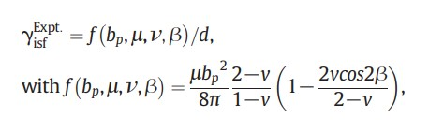
EXPERIMENTAL METHOD
Stacking fault energies are usually considered as an experimentally accessible parameter by means of tem, x-ray or neutron diffractions.
•Methods involving TEM measure the distance (d) between the two a/6 〈112〉 partial dislocations in a dissociated a/2 < 110> dislocation.
•then one connects these parameters to the SFE. In order to minimize the interaction between dislocations, the partial separation width d is usually measured on an isolated straight dislocation line at its equilibrium state, then the SFE is calculated according to :
where μ is the shear modulus on the {111} close-packed planes, bp is the Burgers vector of partial dislocation, v is the Poisson ratio, β is the angle between Burgers vector b and dislocation line direction.

Slide 4
COMPUTATIONAL METHODS
So basically experimental methods can’t be used everywhere, since every time doing experiments aren’t feasible hence we adopt computational methods.
So here, we ran molecular dynamics simulations for calculating and analyze Stacking fault energies and lattice parameters.

Slide 5
SIMULATION DETAILS - SOFTWARE USED : LAMMPS
PARAMETERS - T = 200K,400K AND 650K
POTENTIALS - CO-CR-CU-FE-NI (2021--DELUIGI-O-R-PASIANOT- VALENCIA-F-J-ET-AL--FE-NI-CR-CO-CU)
SUPERCELL SIZES - FCC - 0 10 0 10 0 10
HCP - 0 5 0 5 0 5
DHCP - 0 5 0 5 0 10
COMPOSITIONS [(1.0, 0.0, 0.0), (0.75, 0.25, 0.0), (0.50, 0.50, 0.0), (0.25, 0.75, 0.0), (0.0, 1.0, 0.0),
(0.0, 0.0, 1.0), (0.25, 0.0, 0.75), (0.50, 0.0, 0.50), (0.75, 0.0, 0.25), (0.0, 0.75, 0.25),
(0.0, 0.50, 0.50), (0.0, 0.25, 0.75), (0.125, 0.125, 0.75), (0.125, 0.75, 0.125),
(0.25, 0.25, 0.50), (0.25, 0.50, 0.25), (0.25, 0.375, 0.375), (0.375, 0.25, 0.375),
(0.375, 0.375, 0.25), (0.50, 0.25, 0.25), (0.75, 0.125, 0.125)]

Slide 6
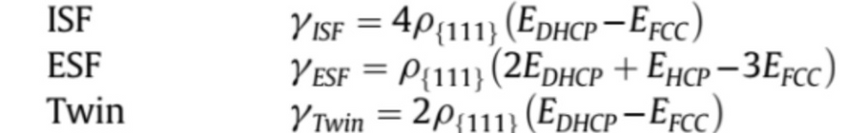
Reference :->https://www.researchgate.net/publication/321250058_High-throughput_estimation_of_planar_fault_energies_in_A_3_B_compounds_with_L1_2_structure?enrichId=rgreq-7d8964ee31bd6493fd0c9c8ece9cb765-XXX&enrichSource=Y292ZXJQYWdlOzMyMTI1MDA1ODtBUzoxMTQzMTI4MTE1OTUwMTcxNEAxNjg0NDAwOTQ1NjQ3&el=1_x_3&_esc=publicationCoverPdf
THEORETICAL BACKGROUND(DMLF)
DMLF model is also known as Diffused multi layer fault model, it can also be used to calculate different types of stacking fault energies for example Intrinsic stacking fault energies, extrinsic stacking fault energies and twin boundary stacking fault energy.
Diffuse Multi-Layer Fault model enables high-throughput computational estimation of planar fault energies.The model accounts for the change in stacking and bonding environment of atoms on multiple atomic layers in the vicinity of the fault
The model of a Stacking Fault Phase separated from the matrix by a sharp interface is supplanted by a Diffuse Multi-Layer Fault (DMLF). This implies that DMLF replaces the older model, suggesting that it offers improvements or a more accurate representation of the stacking fault phenomenon.
Formulas used for calculating stacking fault energies via DMLF model are as follows -

Slide 7
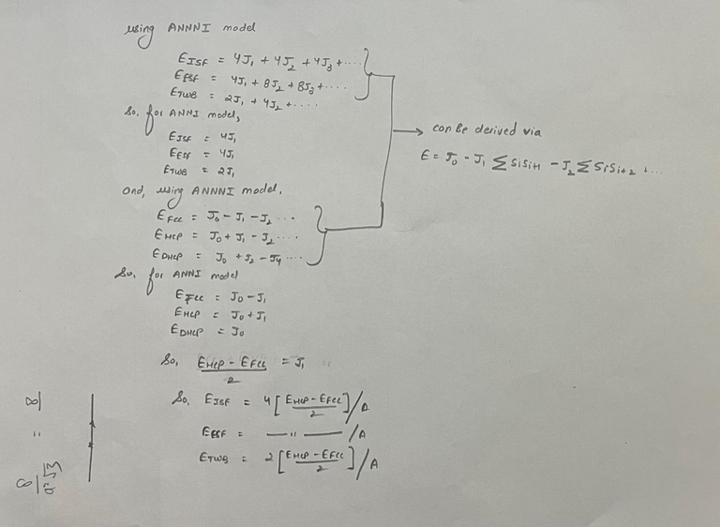
THEORETICAL BACKGROUND(ANNI)
ANNI model is known as axial nearest neighbor model, It is modification of Ising model which is used to calculate Cohesive energies of different types of lattice systems like FCC, DHCP, HCP etc.
Its a statistical model which accounts the presence of different types of atomic layers in the neighbors of the layer being considered by assigning spins to these layers.
Following are the formulas and derivations of ANNI model-

Slide 8
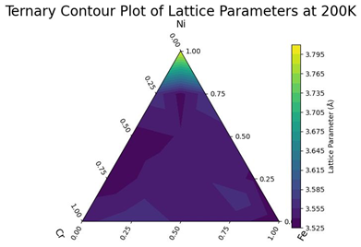
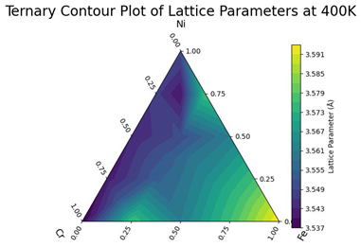
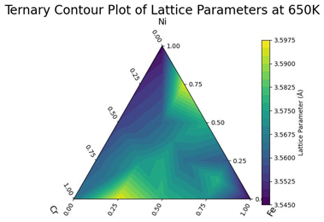
GRAPHS : LATTICE PARAMETERS

Slide 9
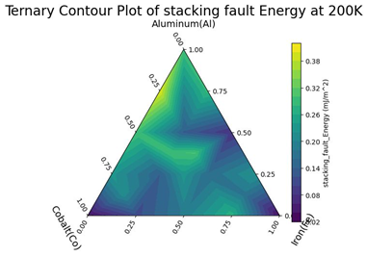
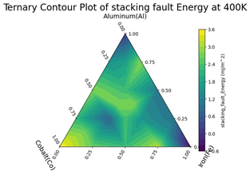
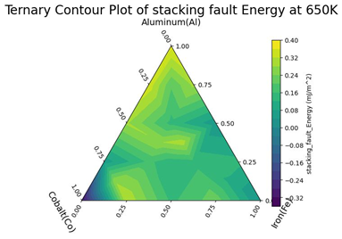

GRAPHS : INTRINSIC STACKING FAULT ENERGY
Nickel
Ni)
Nickel
Ni
Nickel
Ni
Chromium
Cr
Chromium
Cr
Chromium
Cr
BY ANNI MODEL

Slide 10
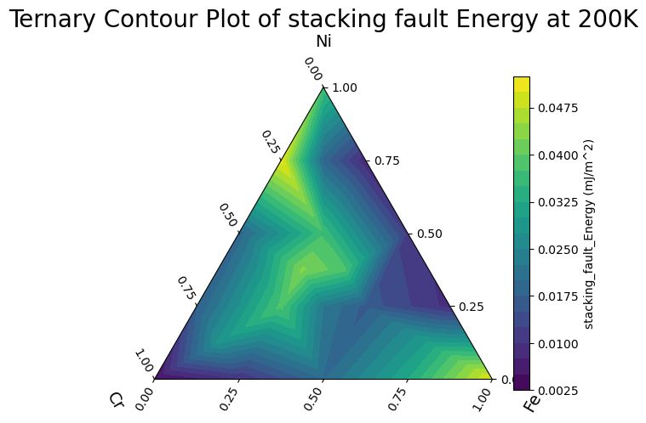
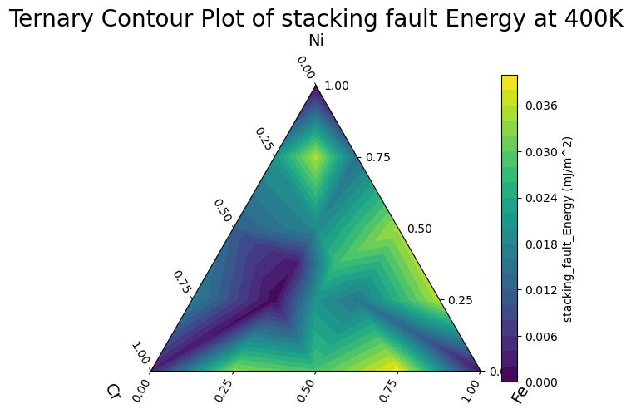
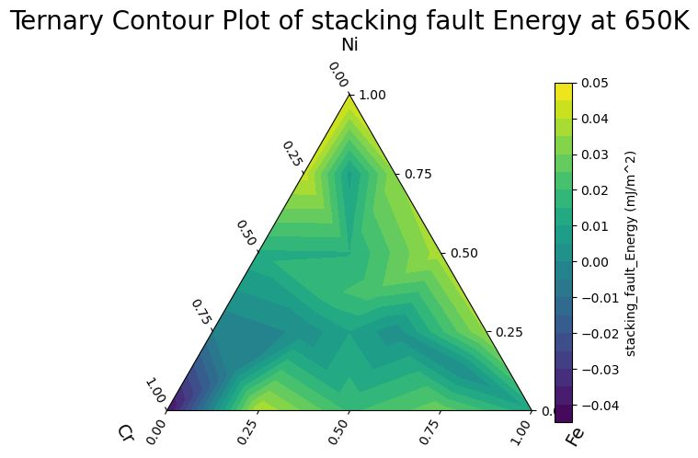
GRAPHS : INTRINSIC STACKING FAULT ENERGY
BY DMLF MODEL

Slide 11
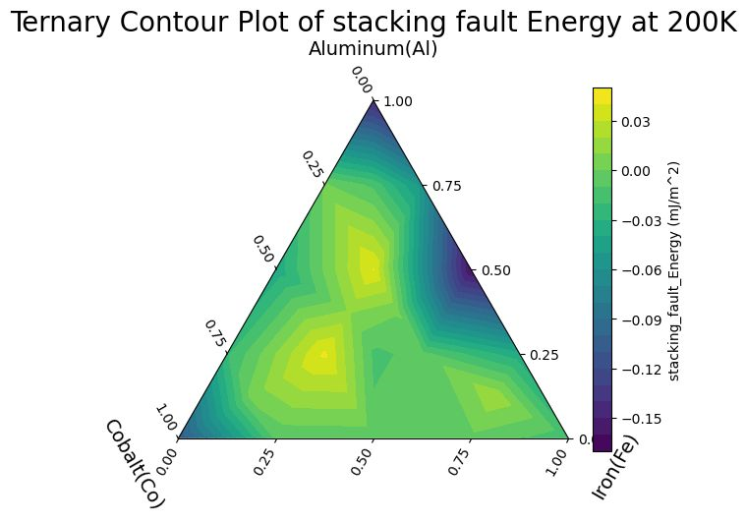
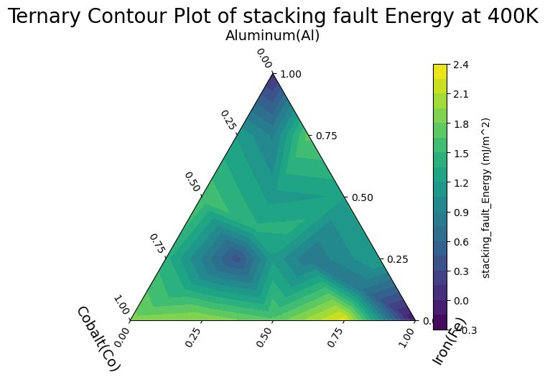
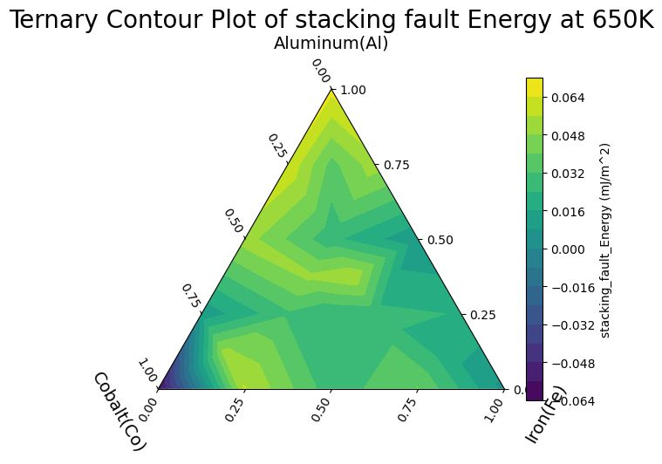
GRAPHS : EXTRINSIC STACKING FAULT ENERGY
Nickel
Ni
Nickel
Ni
Nickel
Ni
Chromium
Cr
Chromium
Cr
Chromium
Cr
BY ANNI MODEL

Slide 12

GRAPHS : EXTRINSIC STACKING FAULT ENERGY
BY DMLF MODEL

Slide 13
GRAPHS: TWIN STACKING FAULT ENERGY
Nickel
Ni
Nickel
Ni
Nickel
Ni
Chromium
Cr
Chromium
Cr
Chromium
Cr
BY ANNI MODEL

Slide 14
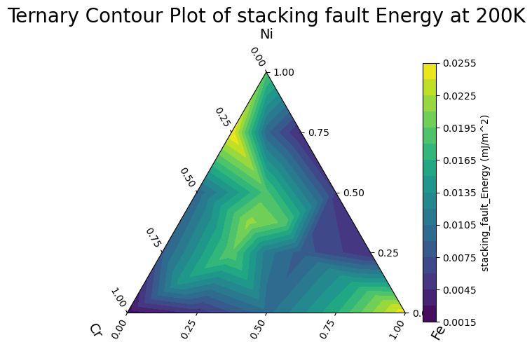


GRAPHS : TWIN STACKING FAULT ENERGY
BY DMLF MODEL

Slide 15
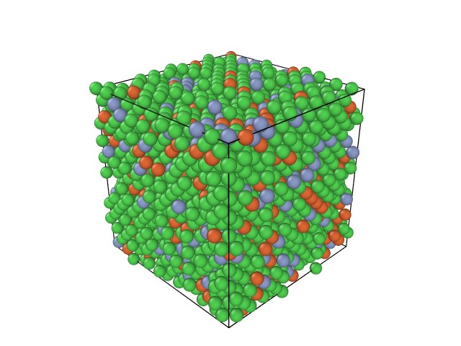
FCC

Slide 16
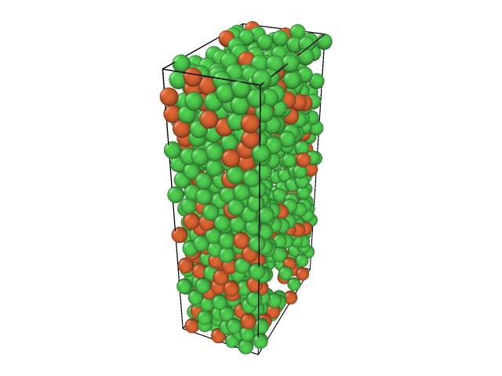
DHCP

Slide 17
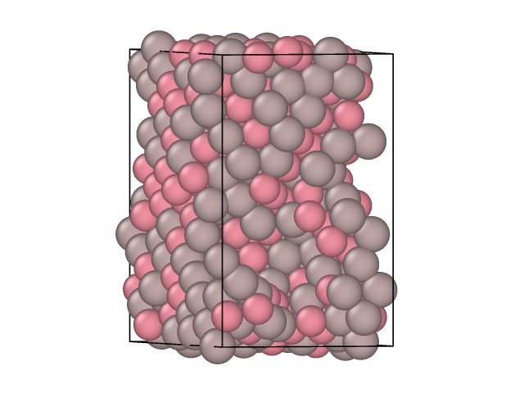
HCP

Slide 19
GRAPHS

